Slide 1

Welcome to
Preceptorship Orientation
School of Nursing

Slide 2
Thank you
Thank you for agreeing to take part in the UAM School of Nursing preceptorship. Preceptorship enhances the quality of learning and strengthens the link between nursing education and practice.
We appreciate your willingness to take part in the learning exercises of our students. If you have any questions do not hesitate to contact the course faculty.
There is a Preceptor Handbook that we ask you to review in addition to this Orientation PowerPoint. The Handbook is found on the UAM School of Nursing Webpage. Your assigned student should direct you to the location.

Slide 3
UAM Mission and Philosophy
The mission the University of Arkansas at Monticello shares with all universities is the commitment to search for truth and understanding through scholastic endeavor. The University seeks to enhance and share knowledge, to preserve and promote the intellectual content of society, and to educate people for critical thought. The University provides learning experiences that enable students to synthesize knowledge, communicate effectively, use knowledge and technology with intelligence and responsibility, and act creatively within their own and other cultures.

Slide 4
UAM seeks to fulfill its mission by:
Offering quality educational opportunities in the form of master’s, baccalaureate, and associate degree preparation, as well as certification in a variety of vocational/technical programs, or workforce training;
Offering a well-rounded program of general education designed to broaden and enrich students’ awareness of the world around them;
Providing contemporary curricula which prepare students for careers in selected fields, for personal development, and for meeting societal needs;
Strengthening students’ capabilities as thoughtful contributors to society by encouraging them to take personal responsibility and seeking the benefits of life-long learning;
Providing support programs which increase the probability of success for those students needing additional academic preparation to meet college standards;

Slide 5
UAM seeks to fulfill its mission by:
Assisting students in developing interpersonal skills needed by responsible and productive members of society;
Providing viable programs of public service, continuing education in selected areas, and cooperative programs with other educational institutions;
Promoting research programs which strengthen the institution and contribute new information to the existing body of knowledge and the extension of knowledge to serve the public;
Providing cultural and aesthetic experiences that will serve to enhance appreciation of the arts;
Maintaining regional and national recognition of the institution and its academic and technical programs by continuing to meet the standards of accrediting bodies, available but yet to be achieved; and
Preparing students to live and work in a technological and global society.

Slide 6
School of Nursing Mission
The overall mission of the School of Nursing is to strive for excellence in the preparation of technical (Associate of Applied Science in Nursing Degree) and professional (Bachelor of Science in Nursing Degree) nurse generalists.
This mission is accomplished through the following goals:
  the preparation of graduates to provide nursing care for individuals, families, and communities within a variety of health care settings.
  the encouragement of critical thinking to guide therapeutic nursing interventions that promote, maintain, and restore health.
  the development of accountability through a commitment to professional nursing practice and lifelong learning.

Slide 7
School of Nursing Philosophy
The faculty holds the following beliefs about the major concepts of person, environment, health, professional nursing and professional nursing education:
PERSON is viewed as an individual, a family, and/or a community and is a holistic adaptive system in constant interaction with an increasingly interconnected global environment. This interaction creates a complex and developing person who has common and unique needs throughout the life span. These needs guide the person to use innate and acquired coping mechanisms in four adaptive modes to produce responses that promote goal adaptation and need integrity.
ENVIRONMENT includes all internal and external stimuli that affect development and responses. Environmental stimuli influence the person to produce responses that promote goal adaptation and need integrity.
HEALTH is a process of being and becoming an integrated holistic person by continuously adapting to change. Adaptive responses enhance goal adaptation and need integrity and, thus, promote, maintain, and restore health. Health is viewed as a continuum throughout the lifespan that is influenced by the person’s risk reduction behaviors and adaptive responses to needs. Persons unable to successfully adapt have ineffective responses and are considered ill.

Slide 8
Philosophy continued
PROFESSIONAL NURSING is an art and a science. Caring and value-based beliefs are integral to professional nursing. The goal of nursing is to assist the person to develop risk reduction behaviors and adaptive responses and, thus, promote, maintain, and restore health throughout the lifespan. Critical thinking is used to implement the nursing process in accomplishing the goal of nursing and to apply research findings which improve nursing practice. The professional nurse uses leadership skills in communicating, collaborating, and negotiating with consumers and other members of the health care team in the delivery and promotion of health services. Prepared at the baccalaureate level, the nurse enacts three major roles: provider of care, coordinator of care, and professional.
PROFESSIONAL NURSING EDUCATION is based upon a liberal arts and science foundation. This foundation forms the basis for the evidence-based practice of professional nursing as a generalist. Baccalaureate education prepares students for entry level professional practice across a variety of settings with culturally diverse populations and provides a foundation for graduate study. The process of professional nursing education guides the student in the acquisition of nursing knowledge, skills, attitudes, and values. The teaching/learning process fosters mutual respect and trust, intellectual development, reflection, critical thinking, and lifelong learning.

Slide 9
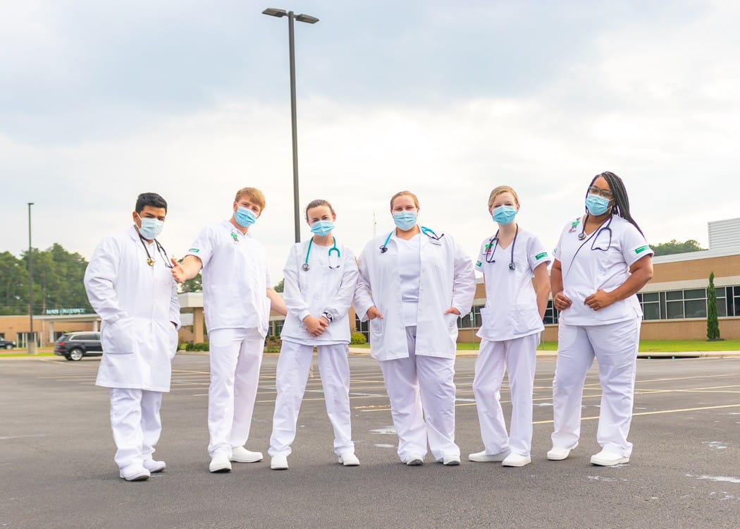
School of Nursing Organizing Framework
The faculty’s beliefs about person, environment, health, professional nursing, and professional nursing education provide the basis for identification of strands that support the curriculum.
Strands include critical thinking, research, nursing process, leadership, communication, and teaching/learning.
These strands, meshed with the Roy Adaptation Model, form the foundation for actualizing the School of Nursing’s philosophy and organizing framework.

Slide 10
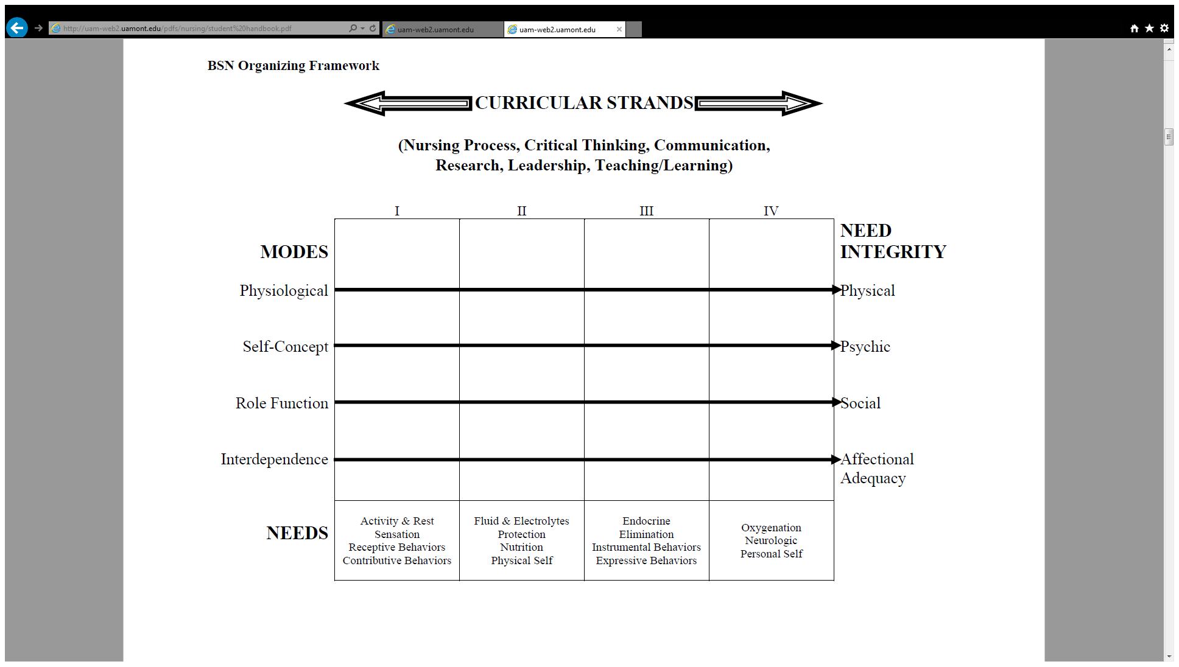
Organizing Framework

Slide 11
Preceptor Criteria
All preceptors must have:
  Current and unencumbered registered nursing license in the state of Arkansas
  Preceptors shall have a minimum of one year experience in the manager position (for precepting in the Leadership and Management course).
  Baccalaureate or higher degree with two years nursing experience.
  Ability to supervise, teach, and evaluate students
  Positive attitude toward the practicum experience, students, and faculty participation.
  Ability to model specific nursing roles (provider, coordinator, and professional) to the student.

Slide 12
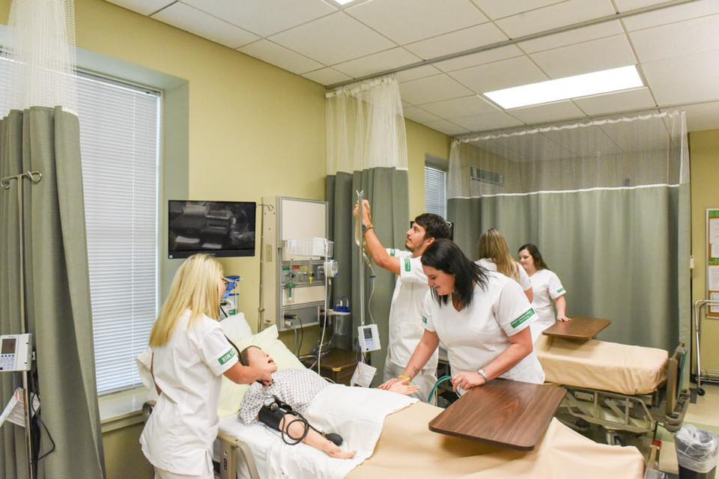
Preceptors
Preceptors should:
  View the UAM Practicum Preceptor Orientation power point on the UAM School of Nursing webpage
  Complete the UAM School of Nursing Practicum Preceptor Form and Contract Agreement to precept
  Submit both forms to the School of Nursing before preceptorship begins

Slide 13
Getting Started
Preceptors will
  Meet with the students to contract for practicum times, discuss student objectives, and indicate acceptance of those objectives
  Assume the teaching, supervisory, and evaluative function of the preceptor role
  Complete formal student evaluation of student at the end clinical.
  Contact faculty as needed to clarify roles

Slide 14
Preceptor Responsibilities
Role model the practice role of the RN with expertise and professionalism
  Students need as many role models in the RN role as they can get
Identify learning experiences for the student
  Sometimes students are nervous about this new experience and identification of learning experiences helps them overcome their anxiety

Slide 15
NURS 3404
Health Promotion
Student Learning Outcomes:
Upon completion of this course, the student will be able to:
utilize the nursing process to provide therapeutic nursing interventions to promote, maintain, and restore health of culturally and ethnically diverse individuals and families;
apply critical thinking that is goal directed, ethical and based on standards of professional nursing practice in providing care for individuals, and families;
communicate and collaborate with individuals, families and communities as well as members of the health care team to provide and improve delivery of health care in a variety of ambulatory care settings;
apply research findings related to health promotion in ambulatory care settings;
provide cost effective quality health care to individuals, families and communities in a variety of ambulatory care settings and
apply teaching learning principles in educating individuals, families and communities to promote, maintain and restore health.

Slide 16
NURS 3064
Healthy Aging
Student Learning Outcomes:
Upon completion of this course, the student will be able to:
Use the nursing process and critical thinking to promote, maintain, and restore the health of culturally and ethnically diverse older adults and their families within their communities.
Using a problem-solving process, formulate conclusions that are goal-directed, ethical and based on standards of professional nursing practice for older individuals, families and communities.
Demonstrate caring of the aging client by promoting an atmosphere of mutual respect and trust in a collaborative environment while providing hope, support and compassion to assist in the achievement of desired outcomes.
Communicate and collaborate with members of the health care team and consumers to provide and improve delivery of health care in settings where health care of older adults is provided.
Effectively validate activities associated with client care through written recordings that reflect quality and accountability in the provision of care.

Slide 17
NURS 3064
Healthy Aging cont.
6. Demonstrate a knowledge of and sensitivity to the beliefs and values of the aging client as well as the impact of diversity on the health care experience.
7. Assist aging clients in varying locations on the wellness continuum to meet their own health care needs, including maintenance of health and/or restoration of function.
8. Facilitate the aging client’s acquisition of knowledge, skills and attitudes that lead to a positive change in health behaviors.
9. Apply nursing knowledge to provide cost-effective quality health care and serve as a client advocate in settings where health care of the older adults is provided.
10. Apply teaching/learning principles to staff education relevant to health care needs of the older adult.
11. Use therapeutic communication to communicate with older clients and their families

Slide 18
NURS 4504 Leadership and Management in Professional Nursing
Student Learning Outcomes:
By the conclusion of the course the student should be able to:
Use leadership and management principles and the nursing process to promote, maintain, and restore the health of culturally and ethnically diverse individuals, families, and communities throughout the lifespan.
Formulate nursing judgments using a problem solving process that is goal directed, ethical, and based on standards of professional nursing practice for individuals, families, and communities.
Communicate and collaborate with members of the health care team and consumers to provide and improve delivery of health care in a variety of settings.
Use critical thinking with leadership and management theories to analyze nursing and/or health research.
Use the best available research evidence in applying leadership and management principles.
Apply leadership and management skills to provide cost effective quality health care and serve as a client advocate in a variety of health care settings.
Apply a change theory to support an identified need for improvement in the delivery of care in a health care setting.
Prepare for NCLEX-RN according to School of Nursing requirements.

Slide 19
QUALIFICATIONS
OF PRACTICUM PRECEPTOR
Licensed to practice as a Registered Nurse in Arkansas or compact state.
Work at an agency that the SON has a clinical agreement with.
A minimum of a BSN with 2 years nursing experience.
Ability to supervise, teach, and evaluate students.
Positive attitude toward the practicum experience, students, and faculty participation.
Ability to model specific nursing roles (provider, coordinator, and professional) to the student.
Function in a leadership/management role (minimum of two years in manager position for the Leadership and Management practicum experience).

Slide 20
EXPECTATIONS
OF THE PRACTITCUM
Complete the Practicum Preceptor Profile form.
Complete the Practicum Preceptor Agreement form.
View the Practicum Preceptor Orientation for each course that is being precepted. Notify the SON Dean and/or course professor when the PowerPoint is read and if any questions exist.
Assist the assigned student to create a practicum calendar outline the dates and times of the practicum experience.
Assis the student to complete practicum learning objectives throughout the practicum.
Orient the student to the physical facility, other health care team members, policies, procedures, and standards of practice in the setting.
Mentor the student on a one-to-one basis.

Slide 21
EXPECTATIONS
OF THE PRACTITCUM
Serve as a role model for the student.
Act as a facilitator in assisting the student to meet personal and practicum objectives.
Assist the student to think critically in making clinical judgments by applying new and previously learned theory and skills and by applying research findings in nursing practice.
Assist the student to gain competence and confidence in assuming responsibility and accountability for actions.
Meet with the student daily (according to an established schedule for the practicum) to direct learning activities.
Contact faculty as needed for issues or concerns about the practicum.
Maintain a record of the student’s performance in terms of achievement of the practicum objectives.
Evaluate the student’s practicum experience using the Practicum Preceptor Evaluation of Student Performance form.

Slide 22

EXPECTATIONS
OF the STUDENT
Assume responsibility for arranging and maintaining a schedule of conferences with the practicum preceptor and faculty.
Maintain a practicum journal according to the Evaluation Criteria for Practicum Journal.
Participate in self-evaluation.
Participate in the evaluation of the practicum experience as a whole.

Slide 23
EXPECTATIONS OF FACULTY OF COURSES USES PRECEPTORS
Responsible for the overall coordination of the practicum experience.
Provide the student with an explanation of the requirements of the practicum experience.
Establish and maintain communication with the practicum preceptor and student.
Maintain on call availability by telephone with the practicum preceptor and student. No weekend assignments unless previously approved by course instructor.
Meet with the student and practicum preceptor, as needed, to facilitate problem solving and guidance.
Meet with the student, as needed, to review progress in meeting personal and practicum objectives for the practicum.
Assume responsibility for the evaluation process of the student’s practicum experience in cooperation with the practicum preceptor.

Slide 24
PRACTICUM OBJECTIVES FOR HEALTH PROMOTION
Along with the personal objectives, the following practicum objectives must be demonstrated by documentation in the practicum journal:
Select and meet with the preceptor; develop personal objectives to be met during the semester; discuss practicum objectives to be met during the semester; develop a calendar of activities; and orient to the agency with the preceptor. Find out about dress code, parking, and how to contact the preceptor in case of an emergency.
Demonstrate knowledge from literature and research pertaining to ambulatory care relevant to the practicum experience.
Identify legal and ethical (based on the ANA Code for Nurses and the Arkansas State Nurse Practice Act) concerns identified in the practicum experience.
Review the quality assurance program in the setting and identify at least three outcome measures from nursing audits. Be specific and analyze thresholds and strategies for improvement if expectations are not met.
Relate the ANA Standards of Clinical Nursing Practice to the standards of practice for clients in the practicum setting.
Identify a need for change and provide rationale for necessity of a change and include in journal entry.
Initiate and maintain communication and collaboration with members of the health care team.
Demonstrate written communication skills appropriate to the professional nurse role.
Determine effectiveness of strategies utilized by the preceptor in delegating activities to other health care team members. Identify additional strategies that may have been useful. Give rationale.

Slide 25
PRACTICUM OBJECTIVES FOR HEALTHLY AGING
Along with the personal objectives, the following practicum objectives must be demonstrated by documentation in the practicum journal:
Select and meet with the practicum preceptor; develop personal objectives to be met during the semester; discuss practicum objectives to be met during the semester; develop a calendar (submit on date due-see Course Calendar) of activities; and orient to the agency with the preceptor. Find out about dress code, parking, and how to contact the preceptor in case of an emergency.
Demonstrate knowledge from literature and research related to healthy aging relevant to the practicum.
Identify legal and ethical (based on the ANA Code for Nurses and the Arkansas State Nurse Practice Act) concerns identified in the practicum.
Review the quality assurance program in the setting and identify at least three outcome measures from nursing audits. Be specific and analyze thresholds and strategies for improvement if expectations are not met.
Relate the ANA Standards of Clinical Nursing Practice to the standards of practice for clients in the practicum setting.
Identify a need for change and provide rationale for necessity of a change and include in journal entry.
Initiate and maintain communication and collaboration with members of the health care team.
Demonstrate written communication skills appropriate to the professional nurse role.
Determine effectiveness of strategies utilized by the preceptor in delegating activities to other health care team members. Identify additional strategies that may have been useful-include rationales.

Slide 26
PRACTICUM OBJECTIVES FOR HEALTHLY AGING cont.
10. Select a client and prepare a case study, including:
a. description of client (biographical data);
b. theoretical framework of aging applied to client;
c. dimensions of wellness;
d. physiologic changes and needs with implications for nursing care;
e. laboratory values with implications for nursing care;
f. environmental safety and security assessment with implications for nursing care;
g. developmental stage and tasks as well as developmental learning needs with implications for nursing care, addressing intimacy, sexuality, belonging and socialization;
h. self-esteem assessment, including crisis and stress management, and transitions and role changes;
i. psychologic changes and needs with implications for nursing care, addressing mental health and mental disorders, cognition capability, psychotropic drug use, gender, cohort and culture; and
j. self-actualization assessment with implications for nursing care, addressing actualizing the self, death, dying and grief, and transcendence, spirituality, and legacies.
Obtain health, physical, functional, nutritional, mental and integrated assessments on your client. Complete the Physical and Functional Assessment Instruments, and Nutritional Screening of Assessments, as well as any other appropriate assessment tools.

Slide 27
PRACTICUM OBJECTIVES FOR LEADERSHIP AND MANAGEMENT
Along with the personal objectives, the following practicum objectives must be demonstrated by documentation in the practicum journal:
Select and meet with the practicum preceptor; develop personal objectives to be met during the semester; discuss practicum objectives to be met during the semester; develop a calendar of activities (student has a due date to complete the calendar); orient to the agency with the preceptor; determine dress code and parking information; and obtain preceptor contact information in case of an emergency.
Demonstrate knowledge of recent research related to the practicum experience (include in-text reference citations and a reference list).
Identify legal and ethical (based on the ANA Code for Nurses and the Arkansas State Nurse Practice Act) concerns identified in the practicum experience.
Review the quality assurance program in the setting and identify at least three outcome measures from nursing audits. Be specific and analyze thresholds and strategies for improvement if expectations are not met.
Relate the ANA Standards of Nursing Practice and Code of Ethics for Nurses to the standards of practice for clients in the practicum setting.

Slide 28
PRACTICUM OBJECTIVES FOR LEADERSHIP AND MANAGEMENT CONTINUED
Identify a need for change and provide rationale for necessity of a change. Change may or may not be implemented at the practicum site depending upon appropriateness and time frame. Write a change paper based on a theoretical framework for the change, including recommended strategies (see Appendix B). The change paper is to be submitted separate from the practicum journal.
Initiate and maintain communication and collaboration with members of the health care team.
Demonstrate written communication skills appropriate to the Leadership/Management role.
Analyze a situation in which conflict occurred. Cite advantage/disadvantages of strategies utilized by the preceptor in resolving the conflict. Identify other strategies that may have been helpful. Cite rationales.
Determine effectiveness of strategies utilized by the preceptor in delegating activities to other health care team members. Identify additional strategies that may have been useful. Cite rationales.
11. Determine preceptor’s leadership and management theoretical framework, cite examples and references.

Slide 29
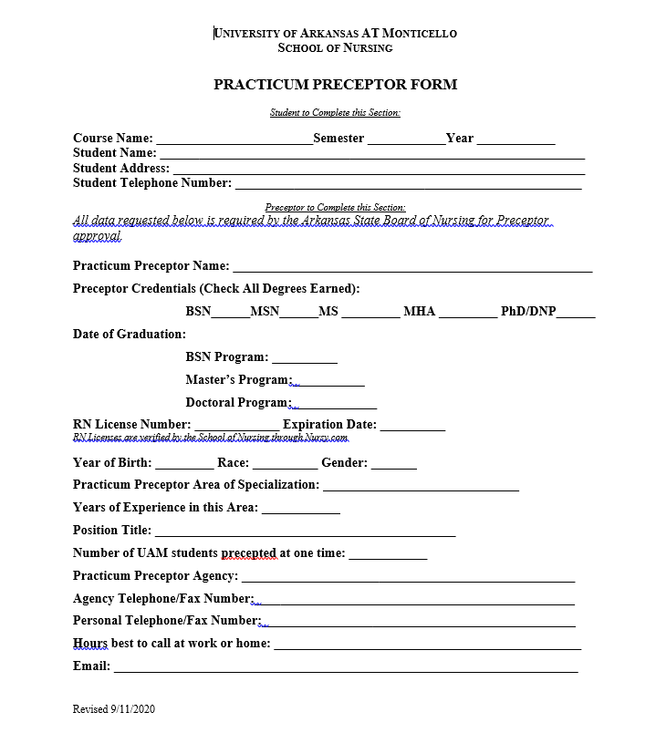
Practicum Preceptor
Form

Slide 30
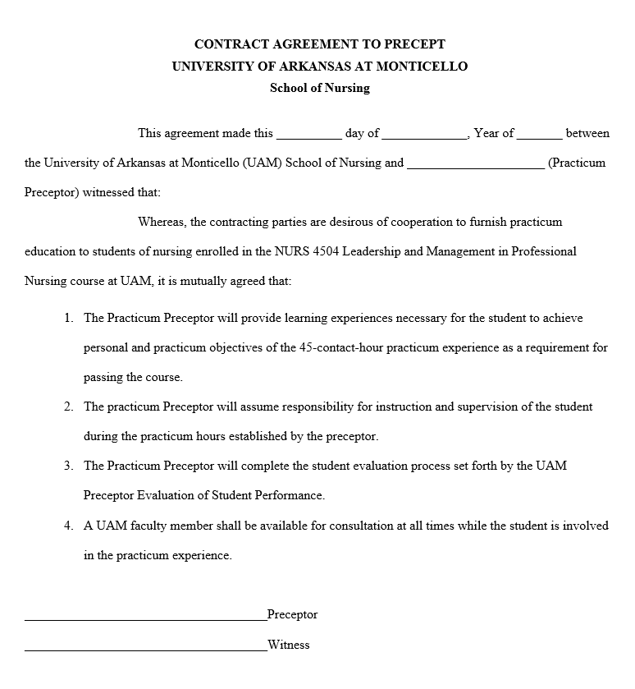
Contract Agreement
The agreement will list the NURS course specific to the preceptorship. Below is an example of the NURS 4504 course. The student will bring this contract to you.

Slide 31
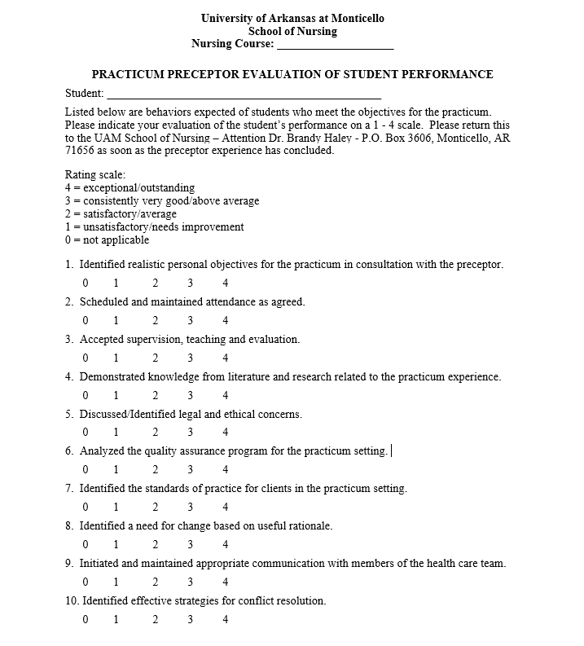
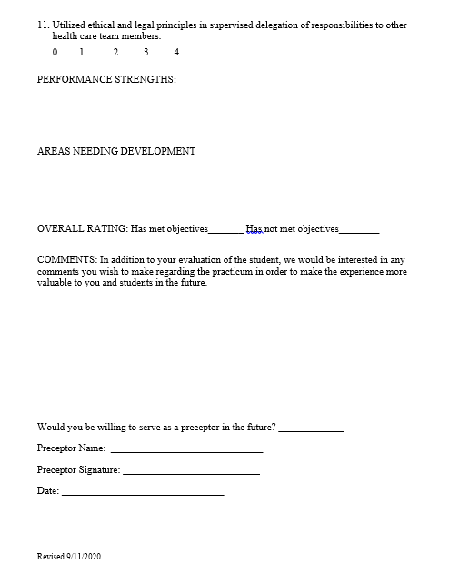
Student Evaluation
The evaluation criteria will be specific to the practicum experience. The student will provide you with a blank evaluation form. This picture is the Leadership and Management evaluation. Health Promotion and Healthy Aging courses may vary in criteria.

Slide 32
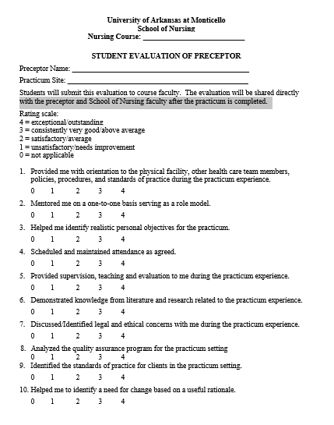
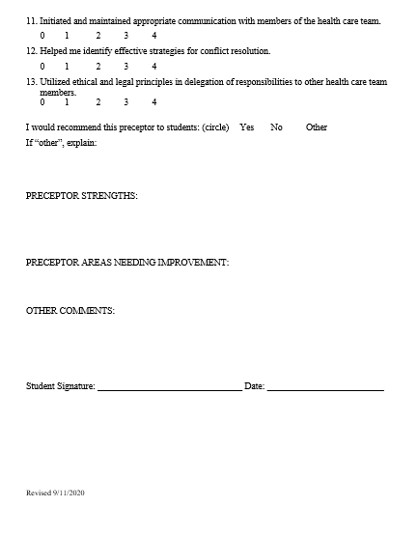
Preceptor Evaluation
The evaluation criteria will be specific to the practicum experience. The student will provide you with a blank evaluation form. This picture is the Leadership and Management evaluation. Health Promotion and Healthy Aging courses may vary in criteria.

Slide 33

Skills students can do
We have asked our students to NOT do technical skills during practicum, if the course professor is not present.
Communication and written skills are allowed as long as the preceptor is overseeing the student.
The preceptor may allow a student to view a procedure or skill with another healthcare team member.

Slide 34
Additional Responsibilities
Explain leadership and management techniques as the opportunities arise (for the Leadership and Management practicum)
Allow the student to assume the role of the RN in decision making and health promotion
  This is the biggest objective for the preceptorship
Actively stimulate critical thinking by use of questions/discussions

Slide 35
Tips for Preceptors
Do’s
  Remember what it was like when you were a student and a new graduate
  Think out loud
  Expect and encourage questions
  Help the student to critically think
    Why are they doing what they are doing?
    How can I facilitate change?
  Set daily goals
  Use humor and compassion

Slide 36
Tips for Preceptors continued
The preceptor and faculty are colleagues of common cause and your input is important and highly valued.
It is important to maintain ongoing contact and open communication with course faculty throughout the preceptor experience, especially regarding concerns or problems.
Problems can often be addressed and corrected easily at first recognition.

Slide 37
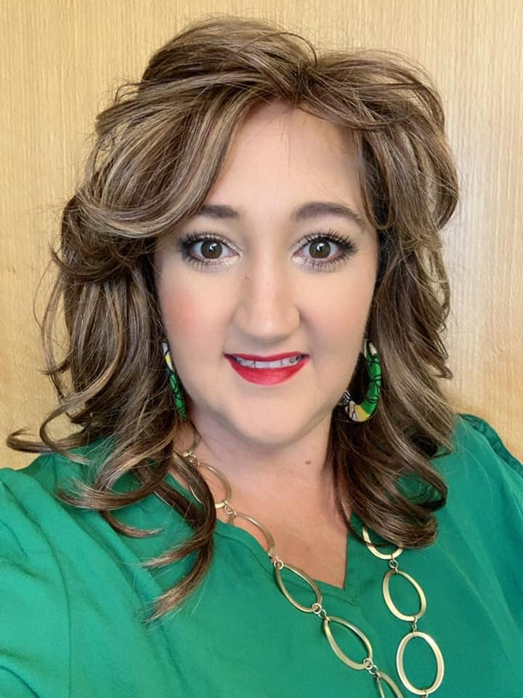
Questions/Concerns
Contact the Dean
Dr. Brandy Haley, PhD, RN
Dean of UAM School of Nursing
Phone: 870-460-1069 ext.1769
Fax: 870-460-1969
Email: haley@uamont.edu
Please email the Dean after you have reviewed this PowerPoint. Your documented completion of the PowerPoint is need prior to the preceptorship beginning.

